Slide 1
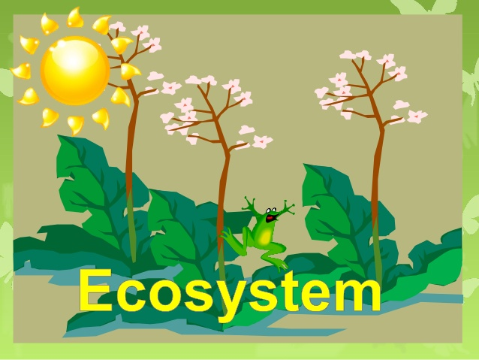
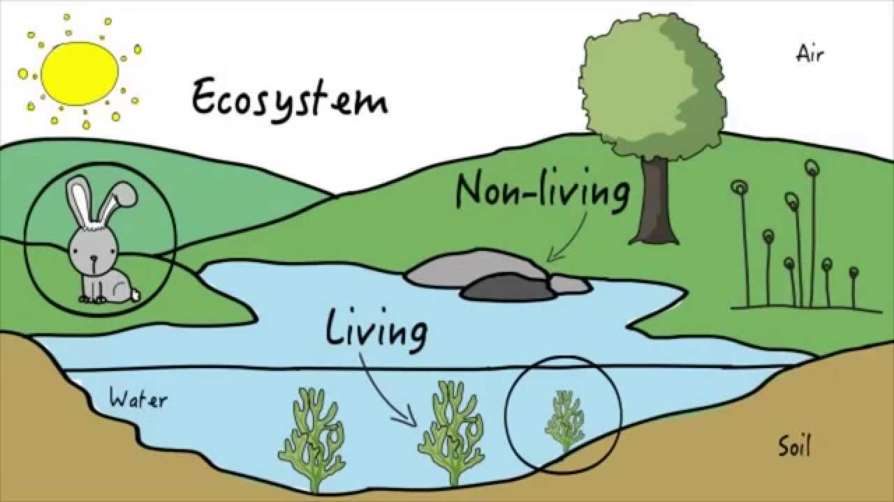
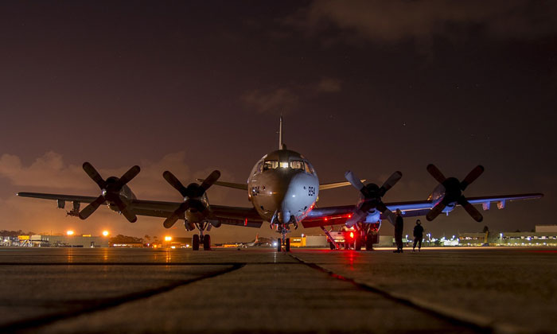
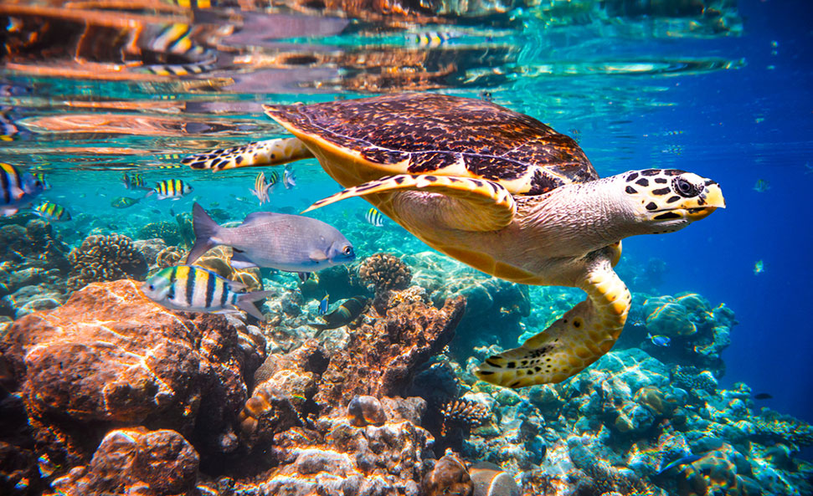
Eco-Systems And Its Effect By Development
Presented By:-
Bhagya Vinod Rana(U19CS012)
Div.: D Roll No:-12
Branch:- Computer

Slide 2
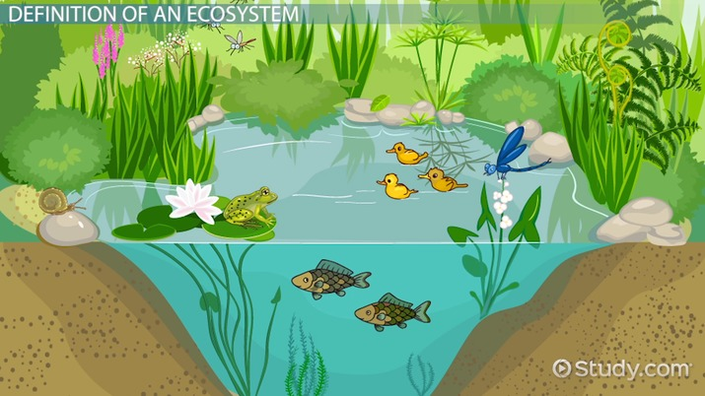
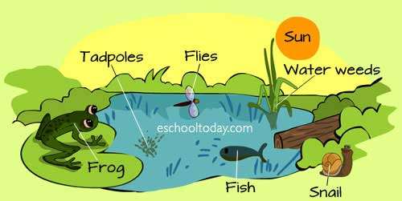
What is Eco-System?
Community of Plants and Animals interacting with each other in a given area, and also with their Non-Living Environments(Weather, Earth, Sun, Soil, Climate and Atmosphere).
Biotic and Abiotic components are regarded to be linked together through Nutrient cycles and Energy flows.

Slide 3
Classification Of Eco-System
ECO-SYSTEM
Terrestrial
Forest
Desert
Aquatic
Marine
Grassland
Mountain
Fresh Water

Slide 4
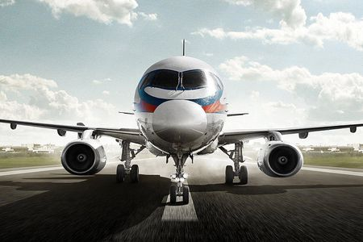
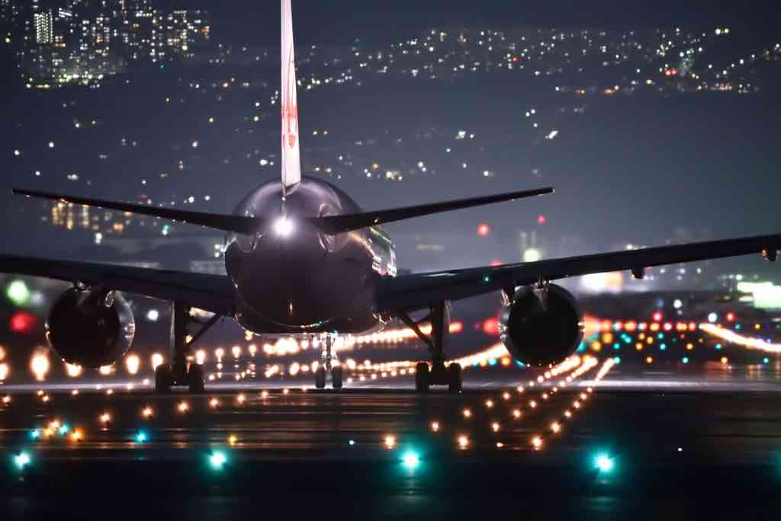
Effect of Development Of Airport Project On Eco-System
Positive impacts include direct and indirect employment, and social (and economic) benefits to people who fly
The negative impacts of airports and aviation include land take, noise, air pollution, climate change, water use and effects on the social structures of local communities.
ALWAYS Remember, ”When there is Development, Degradation is a By-Product”
So, Let us Discuss the Effect on Living And Non-Living Environment.

Slide 5
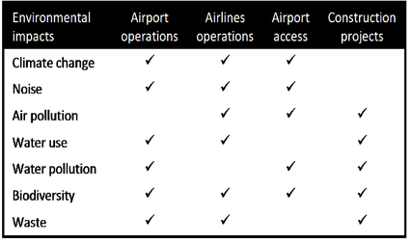

Slide 6
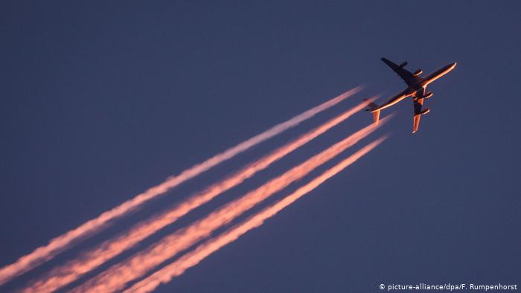
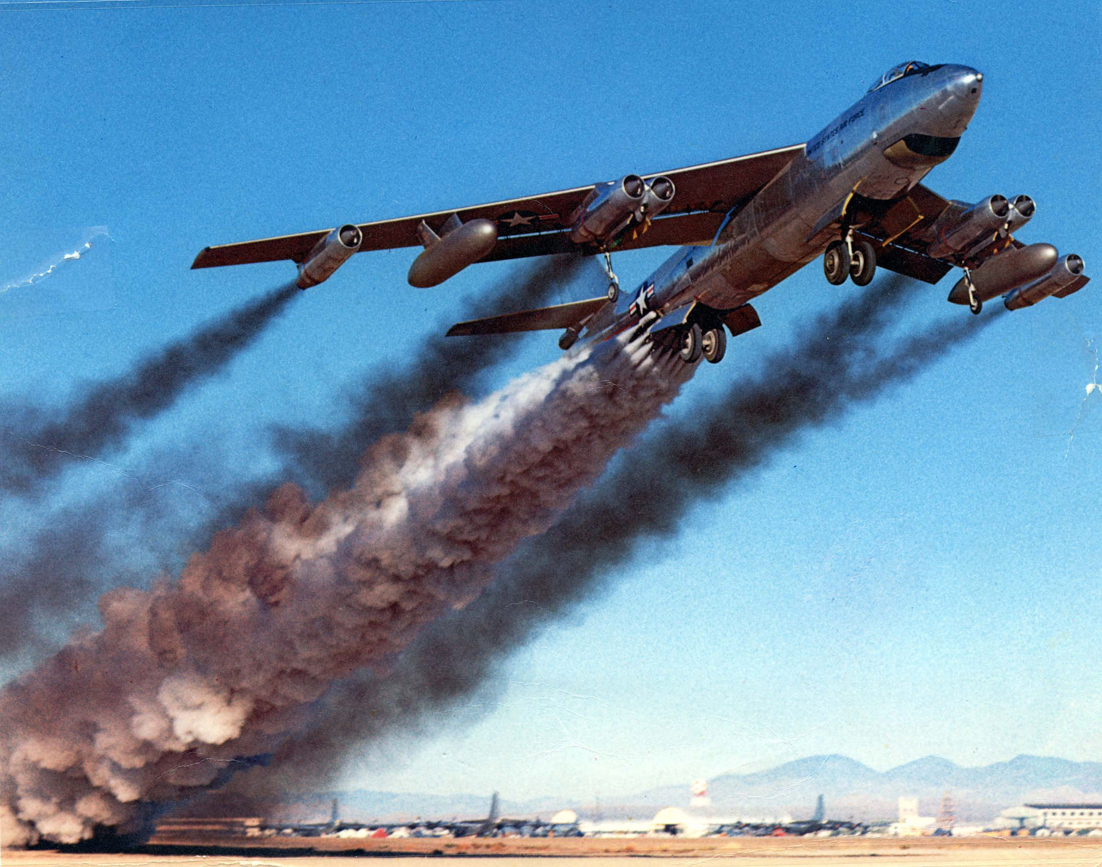
1.)Air Pollution
Combustion of aviation fuel – which is mostly composed of kerosene – produces nitrogen oxides (NOx), carbon monoxide (CO), Sulphur oxides (Sox),hydrocarbons and particulates. It also releases the greenhouse gas carbon dioxide (CO2).
Engines are working inefficiently and unburnt fuel droplets are a source of volatile organic compounds (VOCs).
Vehicles travelling to and from the airport

Slide 7
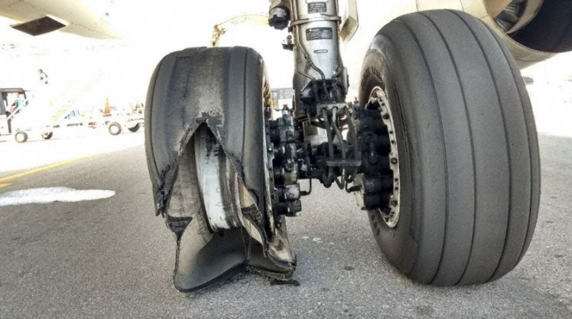
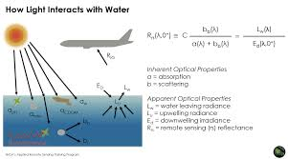
1.)Air Pollution(Continued)
Aircraft Tyres get worn and burnt during take-off and (especially) landing, they release particulate matter (PM).
Construction of airport-related projects can lead to dust.
Air pollution can affect the health of people, animals and plants. Even though aircraft emissions are not included in Kyoto protocol, emissions that are directly controlled by airport operators are ground-based and therefore are subject to national inventories and targets.

Slide 8
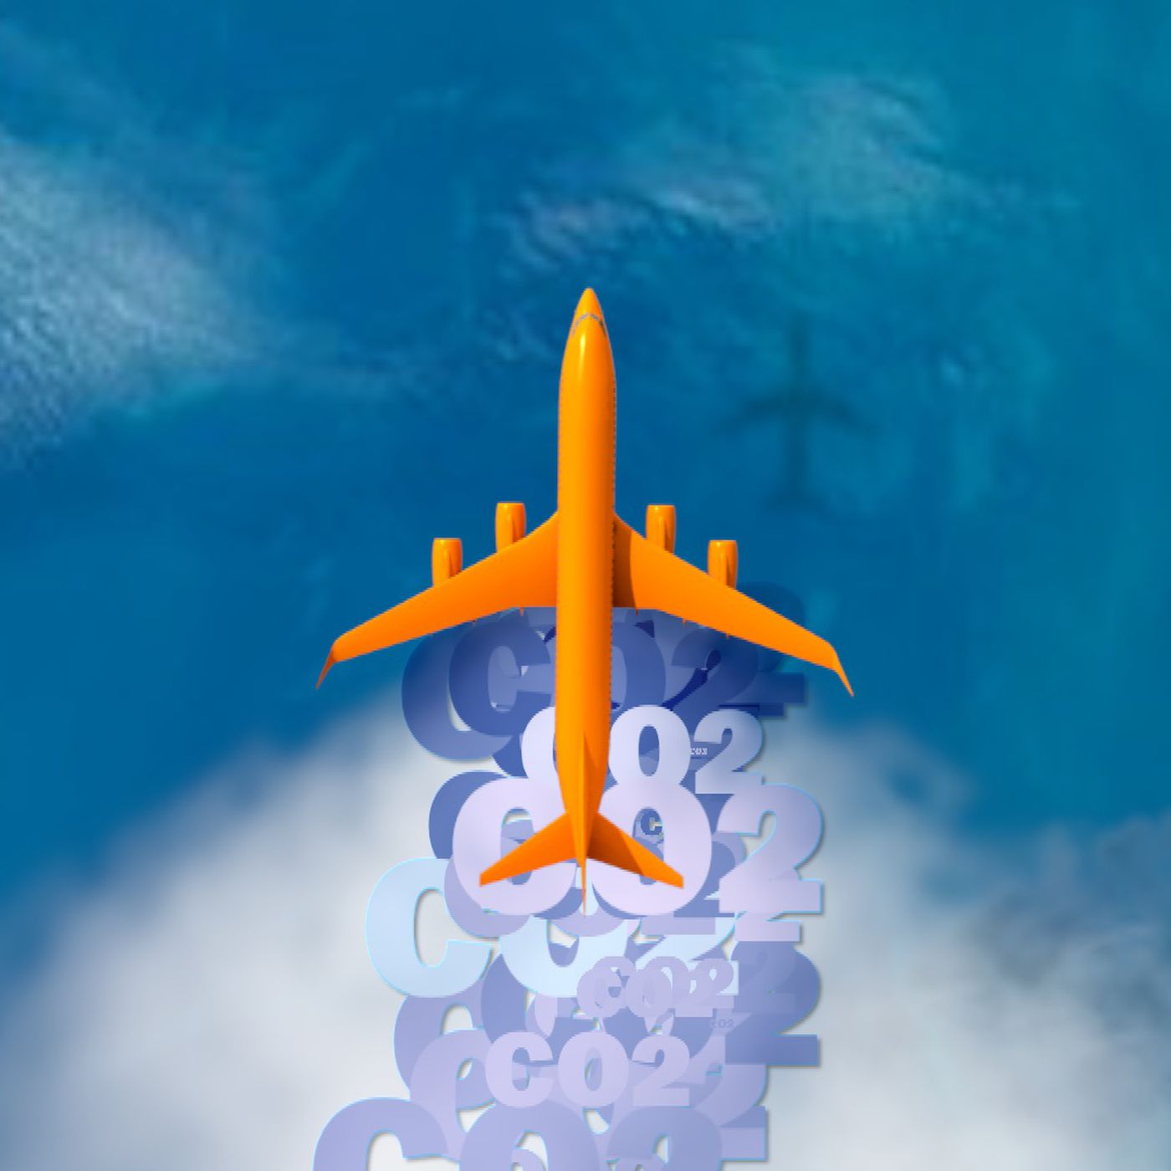
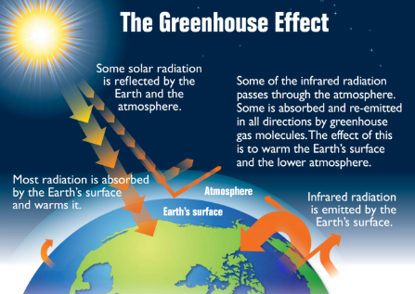
2.) Climate change
Airports and aviation generate greenhouse gases in three main ways:
Flights are by far the largest source. Aircraft emit large quantities of CO2 and Nox during flights, particularly during take-off and landing.
Ground traffic is the second largest source. Vehicles (including construction vehicles) travelling to and from the airport, and around the airport generate CO2
Airport buildings require electricity and heating. Unless this comes from sources that do not use fossil fuel (e.g. hydro- or wind power), the energy production will generate greenhouse gases

Slide 9
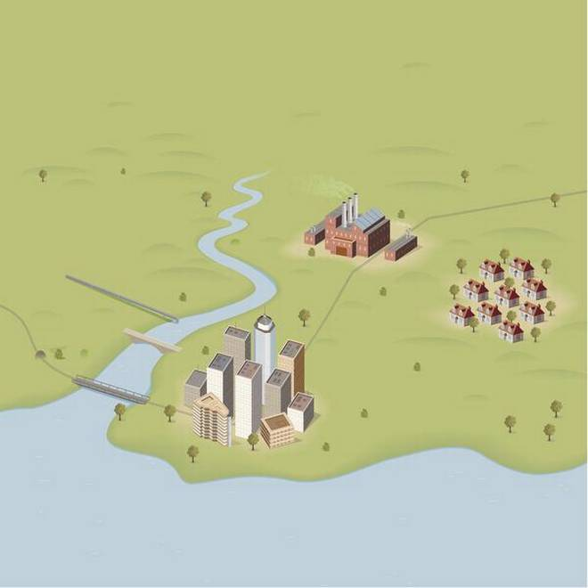
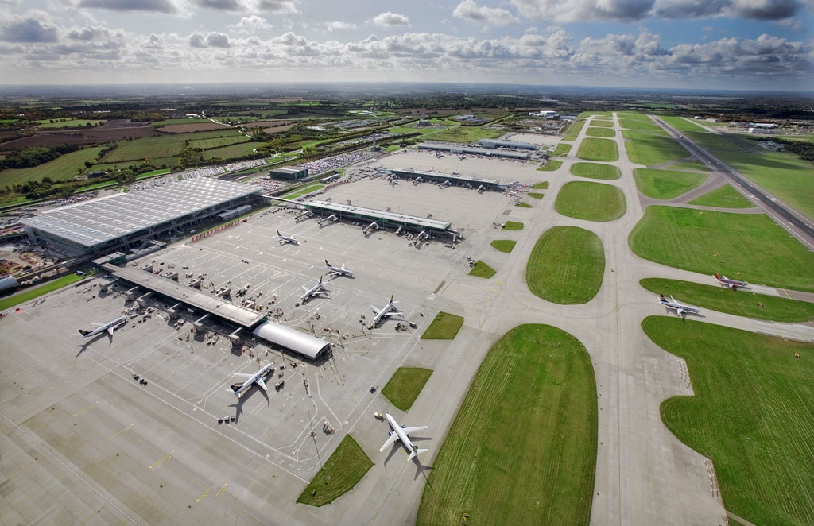
3.)Land take and Urbanization
Land take refers to how much new land is required for the project. Land Take can lead to
Wildlife habitat loss and fragmentation, Loss of agricultural land & Loss of land that could otherwise be used for housing, community facilities, open space and playing fields

Slide 10
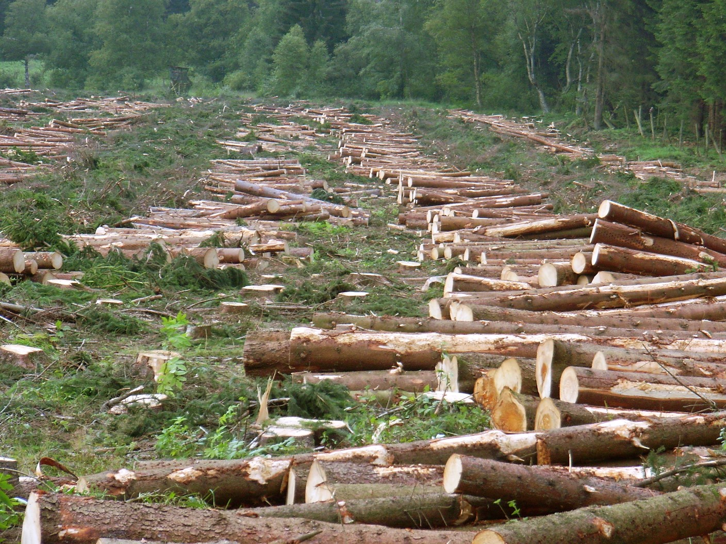
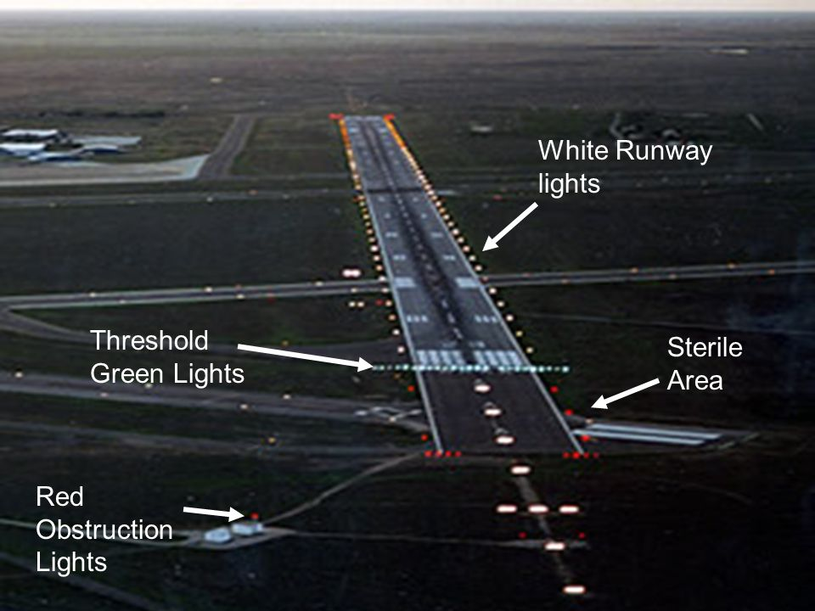
4.) Landscape and visual impacts
Airports and airport-related developments affect the landscape by removing existing landscape features such as trees and hedges and replacing them with buildings and tarmac.
At night, the lights of the runways, aircraft and terminals increase light pollution.

Slide 11
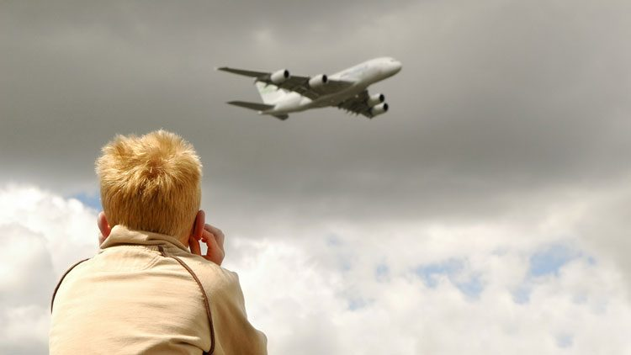
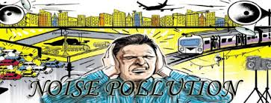
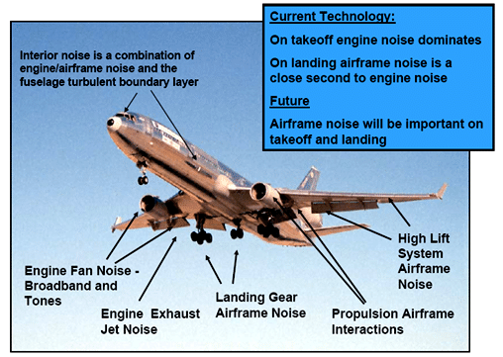
5.)Noise
Noise from aircraft and from traffic going to and from airports is probably the most obvious environmental impact of the aviation industry because it is easily perceived and annoying, especially where this occurs frequently.
Aircraft noise is generated by both the engine and the airframe and is most evident during landing and take-off and under frequently-used flightpaths.

Slide 12
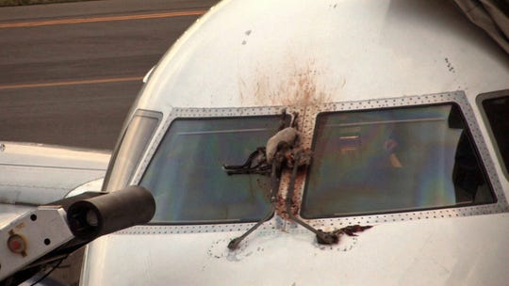
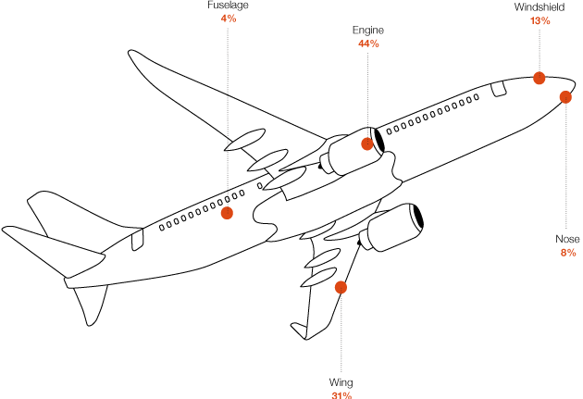
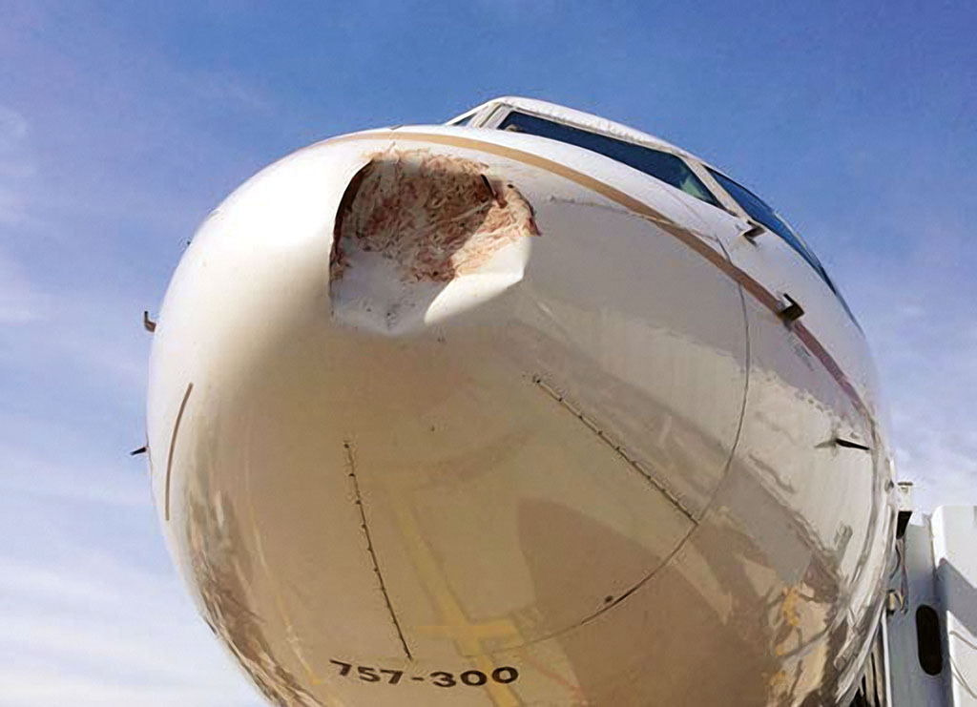
6.)Biodiversity (or nature conservation, or flora and fauna) impacts
These include reduction in the type and extent of habitats;
bird strike and road kill;

Slide 13
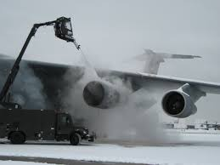
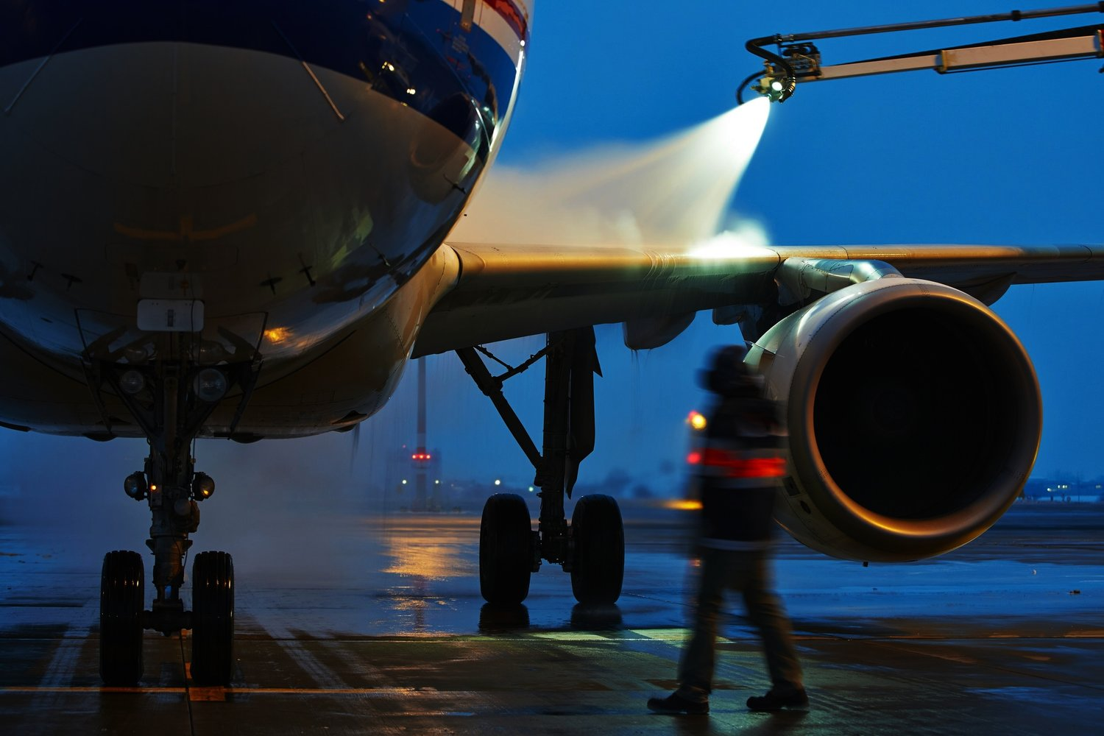
7.)Water pollution
Airports, airport-related development and aviation affect water quality in several ways.
Building works can lead to polluted construction run-off which can affect nearby water bodies.
Airports create a range of potential pollutants including De-icing agents, maintenance and painting chemicals, testing of fire equipment, and fuel leakage and spillage from refueling and storage
Use water for mixing cement, washing wheels and damping down dust, etc.
Operation of such development involve water use for food preparation, toilet flushing, cleaning of the airport and aircraft, fire drills etc.

Slide 14

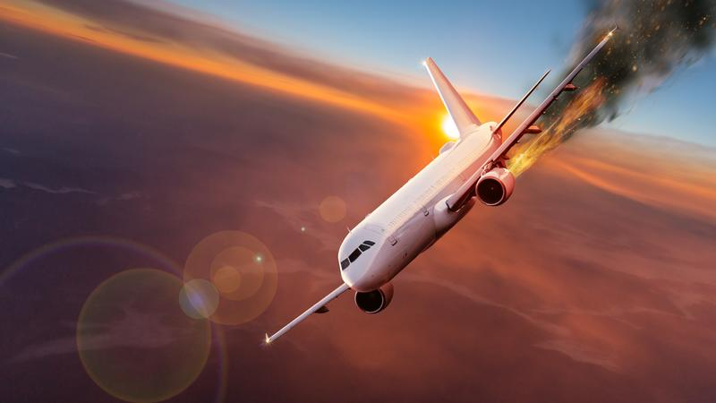
8.)Risk to third parties
Airport-related development and aviation pose risks to air passengers and others (‘third party risk’).
These include road accidents from passengers and workers travelling to and from airports, airplane crashes, terrorism threats, the effects of wake turbulence from aircraft, and health problems of flying for passengers and airline staff.

Slide 15
References
https://sciencing.com/types-environmental-ecosystems-8640.html
https://www.aef.org.uk › uploads › PlanningGuide2
https://www.conserve-energy-future.com/what-is-an-ecosystem.php
http://www.ecosystem.org/types-of-ecosystems
https://greencleanguide.com/airport-environmental-impacts/.
Presented By:-
Bhagya Vinod Rana(U19CS012)
Div.: D Roll No:-12
Branch:- Computer

